Slide 1

MongoDB vs SQL
Aicha Akrout

Slide 2

What is MongoDB
MongoDB is a document-oriented NoSQL database used for high volume data storage.
Instead of using tables and rows as in the traditional relational databases, MongoDB makes use of collections and documents.
Documents consist of key-value pairs which are the basic unit of data in MongoDB.
Collections contain sets of documents and function which is the equivalent of relational database tables. MongoDB is a database which came into light around the mid-2000s.

Slide 3
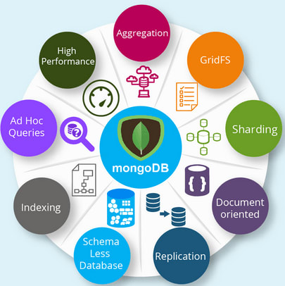
Fonctionalities of MongoDB
Each database contains collections which in turn contains documents. Each document can be different with a varying number of fields. The size and content of each document can be different from each other.
The document structure is more in line with how developers construct their classes and objects in their respective programming languages. Developers will often say that their classes are not rows and columns but have a clear structure with key-value pairs.
The rows (or documents as called in MongoDB) doesn’t need to have a schema defined beforehand. Instead, the fields can be created on the fly.
The data model available within MongoDB allows you to represent hierarchical relationships, to store arrays, and other more complex structures more easily.
Scalability – The MongoDB environments are very scalable. Companies across the world have defined clusters with some of them running 100+ nodes with around millions of documents within the database

Slide 4

What is SQL
Structured query language (SQL) is a programming language for storing and processing information in a relational database.
A relational database stores information in tabular form, with rows and columns representing different data attributes and the various relationships between the data values.
You can use SQL statements to store, update, remove, search, and retrieve information from the database.
You can also use SQL to maintain and optimize database performance.

Slide 5
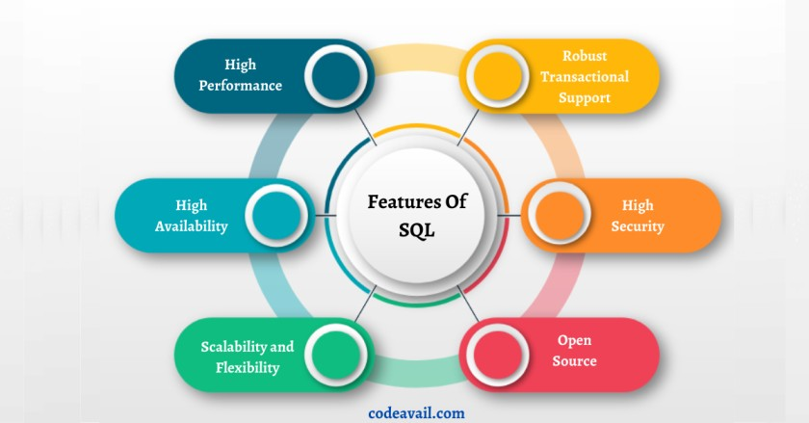
Fonctionalities of SQL
1. High Performance
SQL includes features like high-performance programming skills for highly transactional database systems.
2. High Availability
SQL is cooperative with databases like Microsoft SQL Server, etc. All of these relational database management systems support SQL.
3. Scalability and Flexibility
SQL includes features like Flexibility and scalability.
4. Robust Transactional Support
It also includes the feature that can handle massive records and manage numerous transactions.
5. High Security
It is straightforward to grant permissions on tables, procedures, and views.

Slide 6
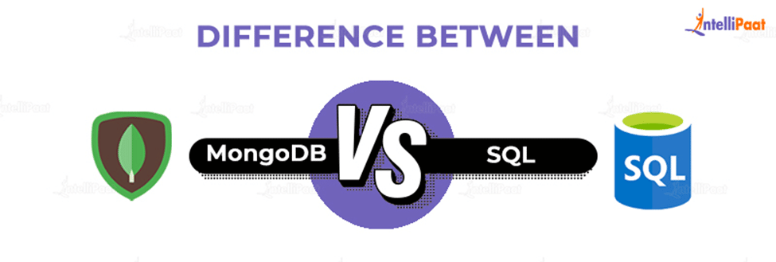
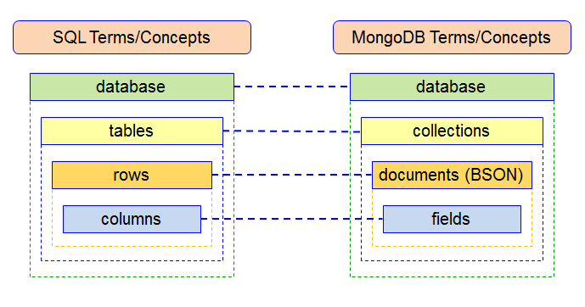
MongoDB vs SQL
In comparison to the SQL server, MongoDB is faster and more scalable. While the SQL server supports JOIN and Global transactions, MongoDB does not. The MS SQL server does not accommodate large amounts of data, however MongoDB does.
Agile practices are supported by MongoDB, although they are not supported by MS SQL Server.
A SQL database processes SQL queries, whereas MongoDB offers JSON querying. MongoDB is a more dynamic and complicated choice that is appropriate for hierarchical data because of its fundamental properties, as opposed to a SQL Database, which is still more predetermined and appropriate for other types of data storage.Hence this is the reason MongoDB outshines the SQL database.

